Slide 1
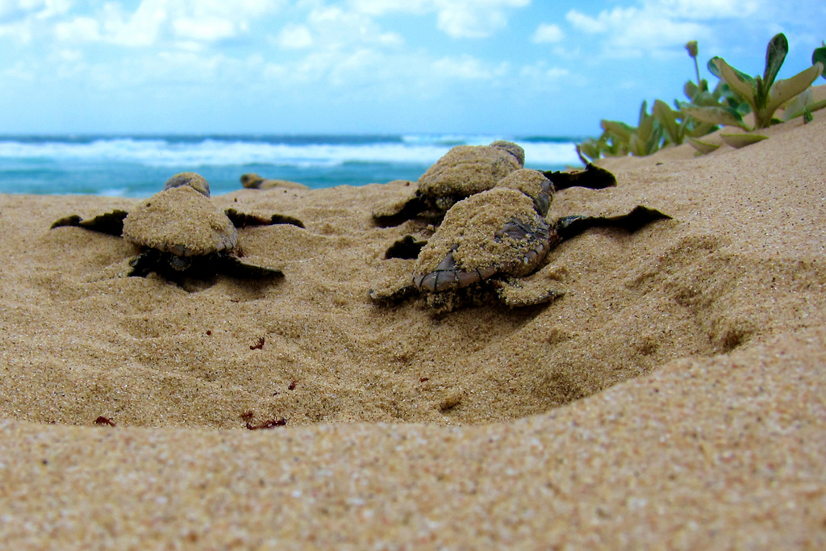
Population Viability Analysis
BIOL 3602 Fall 2022
Emma Hudgins
Nesbitt 338
Emma.Hudgins@carleton.ca
Notes:
If you need extra time with any of the course work because of the storm or are watching this lecture asynchronously because of that, there’s no problem, please take that time – just let me or a TA know what’s up

Slide 2
Where are we?
Learning Objectives
Understand concepts and theories underlying Conservation Biology
Learn tools used by Conservation Biologists to study biodiversity
Develop critical thinking in social, political, and economic dimensions of conservation
Learn about forms of communication of conservation biology knowledge

Slide 3
Why forecast the fate of populations?
https://kevintshoemaker.github.io
Notes:
PVA is essentially a tool for ecological forecasting. Specifically, conservation biologists use PVA to build models to forecast the likely fate of a population in terms of whether it is growing, shrinking, or stable. Here’s a question for everyone: Say you are working for a conservation group helping to conserve a population of hawksbill sea turtles. Why might it be useful to know whether the sea turtle population is growing, shrinking or stable?

Slide 4
Lecture Goals
1. Intro to PVA
2. Count-based PVA
3. Demographic PVA
4. Limitations and extensions to PVA
5. Assignment #1 overview

Slide 5

Why populations?
Charles Krebs (1972):
“A group of organisms of the same species occupying a particular space at a particular time, with the potential to breed with each other
Extirpation: population-level extinction
Notes:
populations are the fundamental units of measuring biodiversity
a species is made up of several populations
but global biodiversity is governed by behaviour of individual populations as units - extirpation vs. extinction

Slide 6
1. Population Viability Analysis
Why?
Choosing among management options
Assessing harvest limits
Determining thresholds for restoration
Assessing current risk of extinction
And many more!
Notes:
Go quickly

Slide 7
1. Population Viability Analysis
The process of evaluating data and models to determine the likelihood that a population will persist for a defined amount of time

Slide 8
PVA process
Develop objectives
Develop model(s)
Collect necessary data
Fit models to data
Identify best management options
Implement management, monitor the consequences
Notes:
Does this process remind anyone of any other conservation framework?
Very similar to adaptive management and structured decision making
All methods require clear definition of time horizon and acceptable level of extinction risk. Obviously subjective – importance of working with decision makers
example of sea turtles – might want to ensure population is stable for the next 50 years with a minimum population size of 500 individuals. Decide on a population model that makes sense for your population, and collect information on sea turtle growth rates. Use this model to determine which intervention strategies, like adding new protected areas, could move the population from a shrinking to a stable phase. Implement the best strategy and continue to collect data to ensure the population behaves as you’d expect.

Slide 9
Northern Spotted Owl (Strix occidentalis)
Threatened by habitat destruction from logging
Two independent statistical PVAs predicted serious declines in Spotted Owl populations over the next 100 years if logging continued unchecked
altered logging legislation (1990s) and conservation practice
Continues to decline today
Lande et al. 1988 Oecologia.; Lamberson et al. 1992 Conservation Biology
Notes:
Northwestern US into BC, but now estimate <6 individuals in BC
3000-5000 in the wild; declining by 3.7% per year.
Important species for protecting old growth forests in general
Any questions on the goals of PVA at this point before we get into specific types?

Slide 10
Basic types of PVA
a. Count-based PVA
All individuals are identical
b. Demographic PVA
More information on population structure
Notes:
We’ll touch briefly on extensions to both of these at the end

Slide 11
2. Count-based PVA modelling whole-population growth rate
Notes:
Now that we’ve covered an intro to PVA we’ll start talking about Count-based PVAs

Slide 12
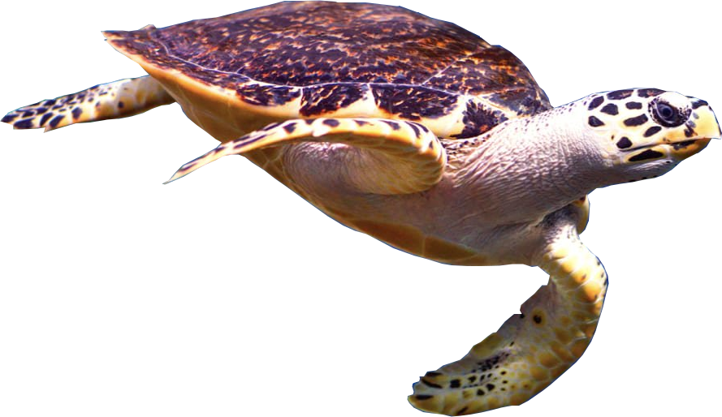
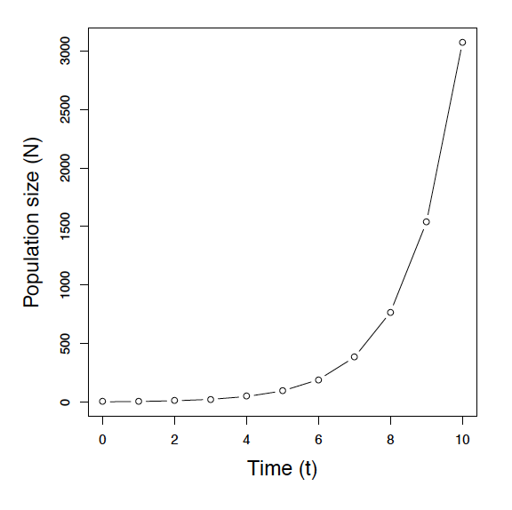
Density-independent population growth
Geometric growth: constant growth rate at each discrete timestep
N_{t+1} = N_{t}𝞴
𝞴 = finite (asymptotic) rate of increase
Notes:
N= population size subscripted by time
N_o is the initial population size
Good for non-overlapping generations with a distinct breeding period

Slide 13
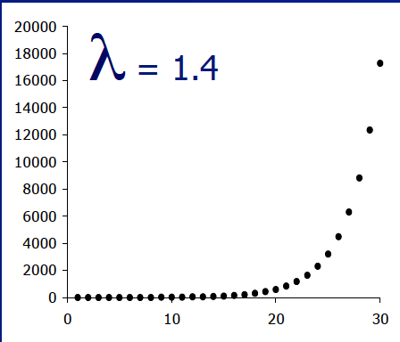
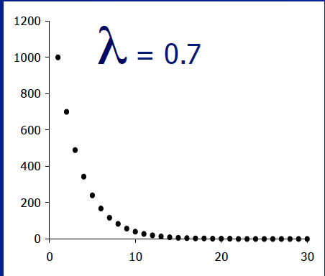
Typical Count-based PVA
λ >1 population grows,
λ <1 population shrinks,
λ =1 population is stable

Slide 14
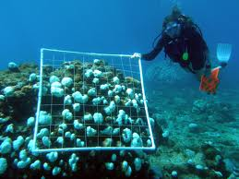
How to acquire data for a count-based PVA?
Mark-recapture studies
Aerial surveys
Camera traps
Audio recorders
Quadrats
“Catch per unit effort”
Other sources?
Fish and wildlife commission, Flickr
OceanMatters
Notes:
Many of these are models in themselves
Go fast

Slide 15
Bald Eagle recovery
US Christmas Bird Count
Notes:
Bald Eagle trends in Christmas bird count
Bald eagles recovering after banning of DDT
Why do the trajectories not match the geometric series?

Slide 16
Major sources of stochasticity (random variation)
Demographic stochasticity
Random variation in individual birth and death
Environmental stochasticity
Random changes in the environment that impact the entire population’s vital rates
Notes:
Stochasticity – unpredictable variation based on the model caused by additional unmodelled factors
-stochasticity - repeating history multiple times leads to different results, expected mean behaviour but some variation around that mean
Also Natural catastrophes, Genetic stochasticity-.

Slide 17


Demographic stochasticity
p(extirpation) = p(individual death)^{N}
Smaller populations are more variable, even with equal mean rates
Notes:
Small sample sizes are more variable, purely based on statistics. If you think of death as a chance event similar to flipping a coin, the fewer coins you have to flip, the greater chance they’ll all land the same way. The same is true for populations, where extirpation risk increases with decreasing population size

Slide 18

Environmental stochasticity
Variation in demographic rates for the entire population
Notes:
Environmental stochasticity- due to temporal variation of habitat parameters & the populations of competitors, predators, parasites, & diseases.

Slide 19
Effects of Stochasticity
Population Size
Noaa.gov
Year
Notes:
10 scenarios of the fate of a population of 10 individuals, simulated in Excel. Applied the same constant growth rate with some random variation.

Slide 20
What effects do population size and variability have on viability?
Notes:
We are now going to do a quick quiz to test how you think different factors influence viability

Slide 21


smaller populations have lower viability
smaller populations have higher viability

Slide 22
Increase Population size
Population Size
Noaa.gov
Year
Notes:
Constant growth rate over 10 years – initial population goes extinct 20% of the time
Deterministic model growth rate is not equal to the mean growth rate of the stochastic model - it is much lower

Slide 23
populations with more variable growth rates have lower viability
populations with more variable growth rates have higher viability

Slide 24
Increase variability
Population Size
Noaa.gov
Year
Notes:
Constant growth rate over 10 years – initial population goes extinct 20% of the time
Deterministic model growth rate is not equal to the mean growth rate of the stochastic model - it is much lower

Slide 25
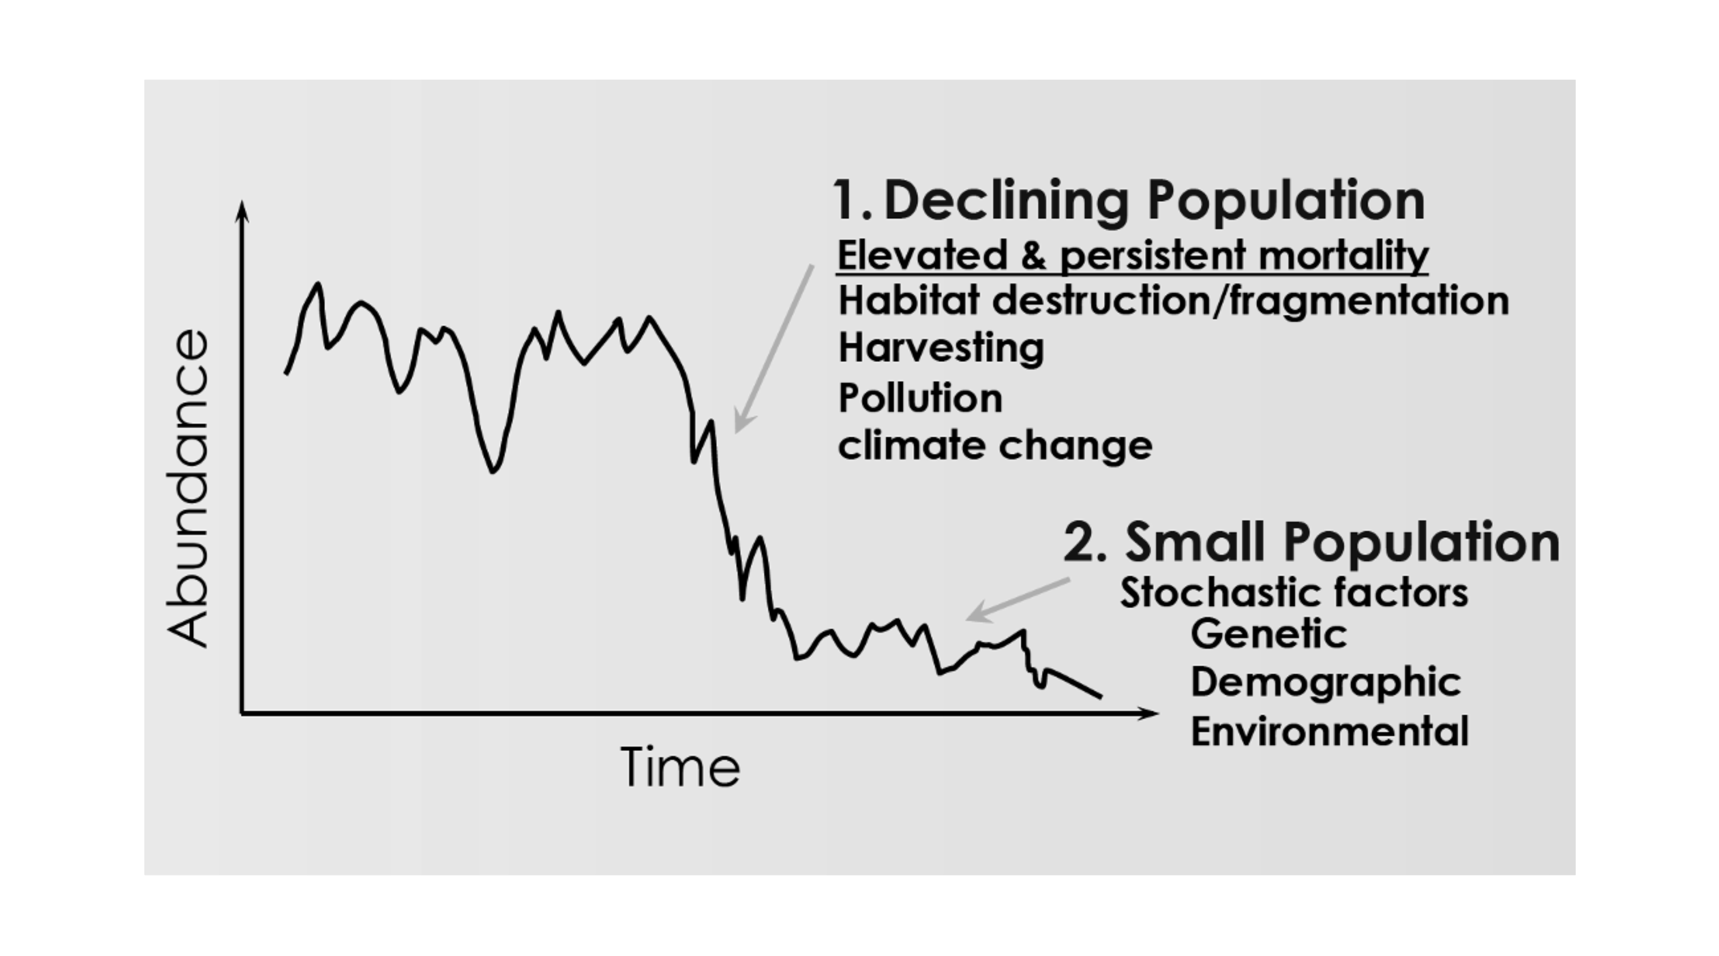
Population quasi-extinction
Population size at which extinction risk reaches some important management threshold.
Gonzalez, A. (2014)
Notes:
Since population viability decreases with population size, keeping populations above 0 is not enough for long term persistence
Managers look for early warnings of population collapse

Slide 26
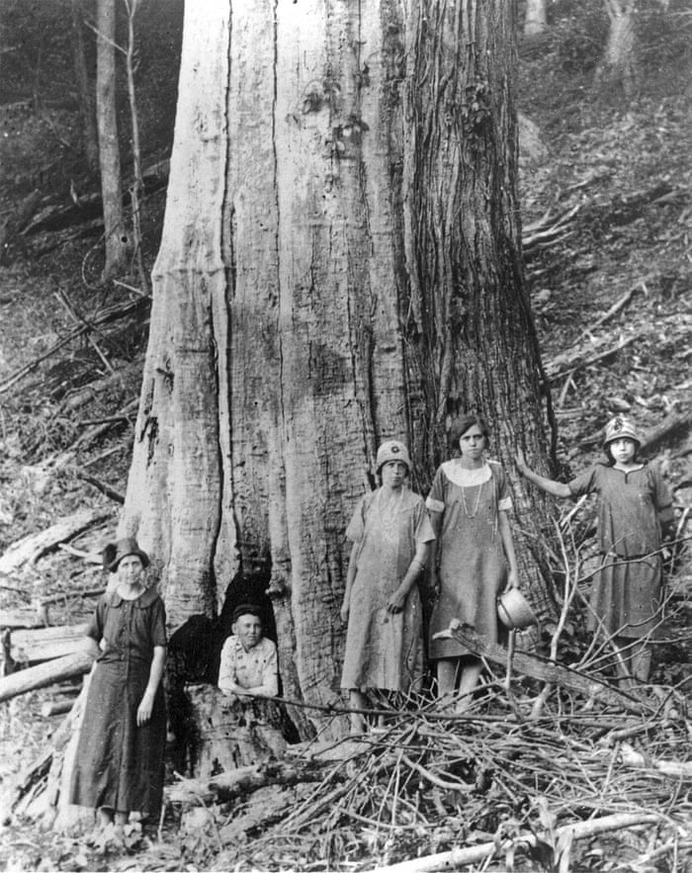
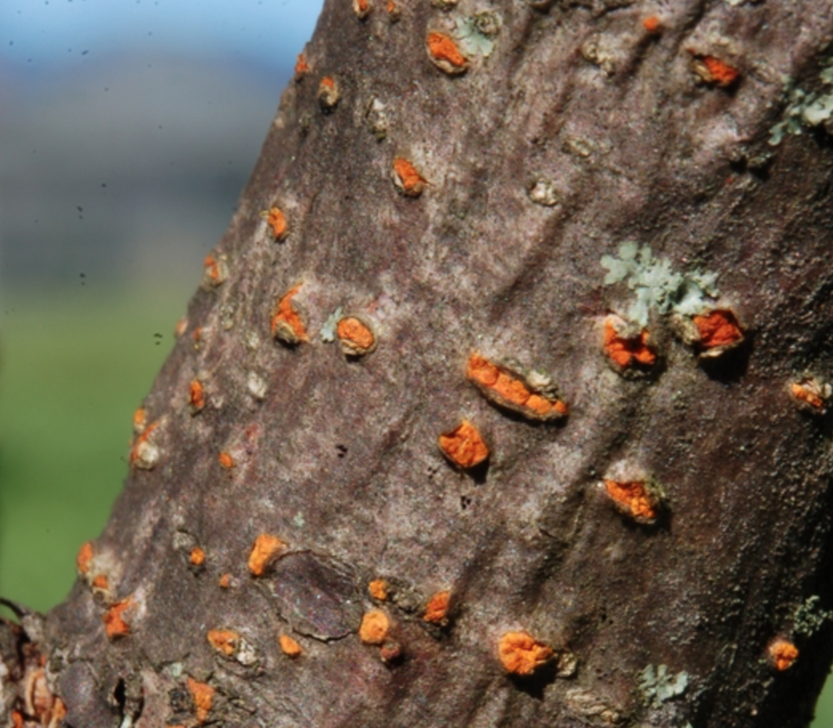
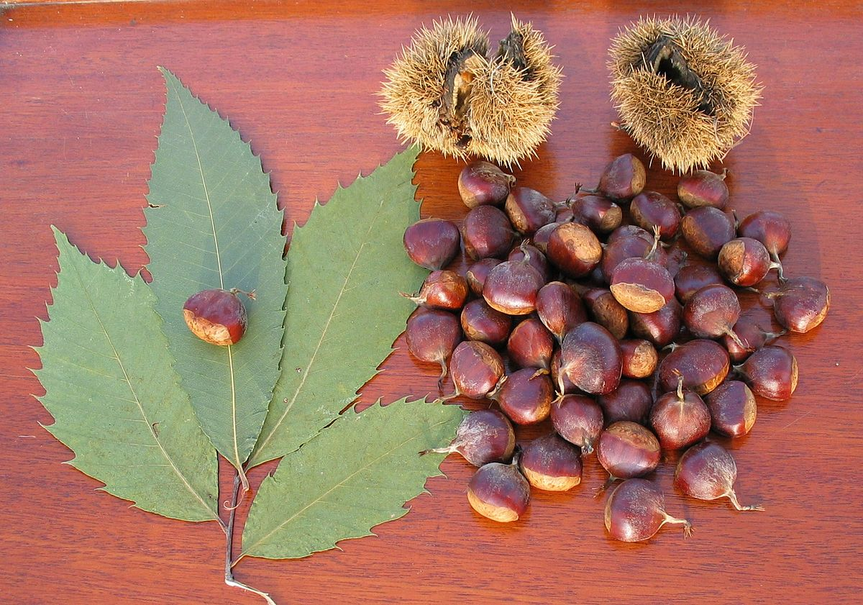
Functionally Extinct:
American Chestnut (Castanea dentata)
Cryphonectria parasitica,
Chestnut Blight fungus
The Guardian
Wikipedia
Forestfloornarrative.com
Notes:
American chestnut (Castanea dentata)
Once the most common nut tree in Eastern North America.
Was a major primary producer for forest ecosystems.
A source of food for a wide range of species
Early 1900s (chestnut blight):
Fungal disease killed an estimated 4 billion trees.
Less than 0.1% remain
population loss means this species is no longer an important contributor to its ecosystem.
American chestnut is now functionally extinct.

Slide 27
Minimum viable population (MVP)
Shaffer (1978)
A threshold number of individuals expected to guarantee a particular probability persistence for a particular period of time
e.g. 95% certainty over 100 years
Population Size
Year
Notes:
Mark Shaffer (1978) evaluated the viability of the Yellowstone grizzly bear population
PVA has since become a cornerstone defining the field of conservation biology
Actual size of MVP can greatly vary across contexts and depends on factors like how variable the species’ demographic rates are, its generation time, and its range size.
95% over 100 years is subjective and depends on the amount of risk different decisionmakers are willing to take

Slide 28

When eradication is the goal
Bringing invasive species populations down below a quasi-extinction threshold (Tobin et al. 2011 Ecology Letters)
Nytimes.com
Notes:
Any questions on count-based PVA, stochasticity and minimum viable popoulations before I move on to demographic PVA?

Slide 29
3. Demographic PVA structured population models

Slide 30
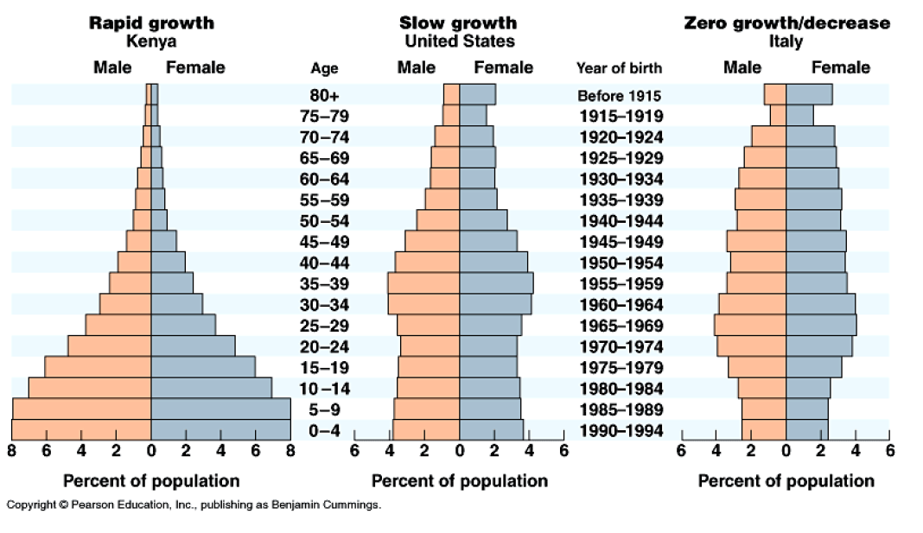
Age-structured populations

Slide 31
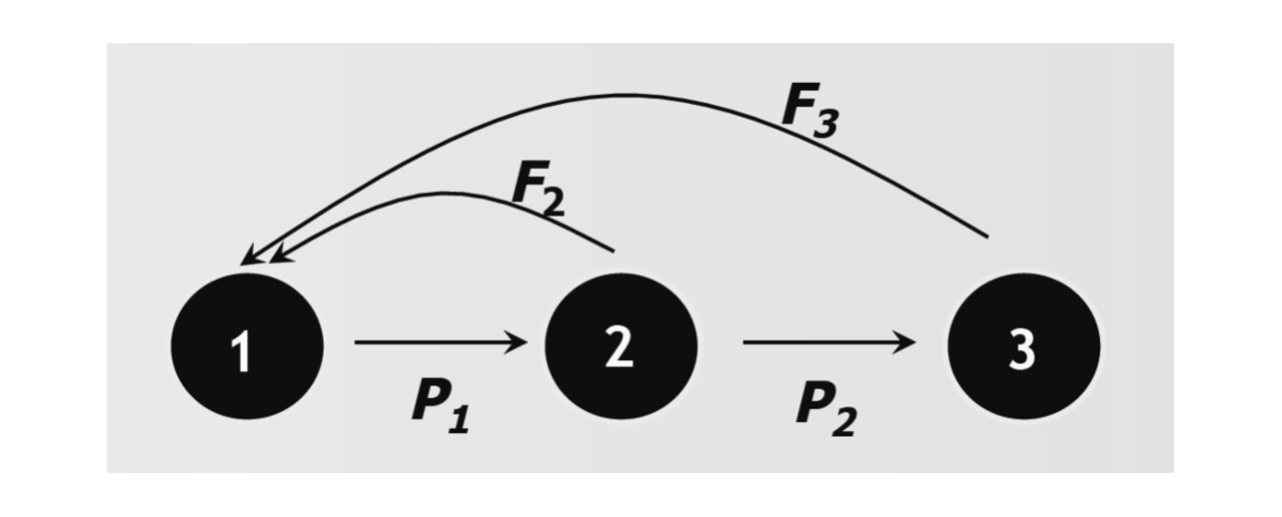
Age-Structured Population Model
Notes:
Life cycle graph
Those who don’t survive die with probability 1-P
Assume that in the first year, individuals can’t reproduce, so they have no fertility or F function
The 2nd and third ages can reproduce and therefore contribute to age class 1 at the next timestep
In this example, all individuals die after the third year, so there’s no P for the 3rd class

Slide 32
Age-Structured Population Model
F_{i} = fecundity of age class i
E.g. F₂= 3, a female in age class 2 births an average of 3 females per year
Notes:
Life cycle graph
Those who don’t survive die with probability 1-P
Assume thatin the first year, individuals can’t reproduce, so they have no fertility or F function
The 2nd and third ages can reproduce and therefore contribute to age class 1 at the next timestep
In this example, all individuals die after the third year, so there’s no P for the 3rd class

Slide 33
Age-Structured Population Model
P_{i} = survival (persistence) of age class i
E.g. P₁= 0.75, 75% of females in age class 1 survive and grow to age 2

Slide 34
Why only examine females?
Females often dominate the population dynamics
Assumed to be not limited by availability of male mates
Assume that males and females have the same survival
(Shyu & Caswell 2018)
Notes:
Go fast, just say 1st point
For vertebrates, since females typically carry the offspring, they are limited in the number of offspring they can produce more than males
Shyu & Caswell et al. 2018

Slide 35
Mathematical representation

Slide 36
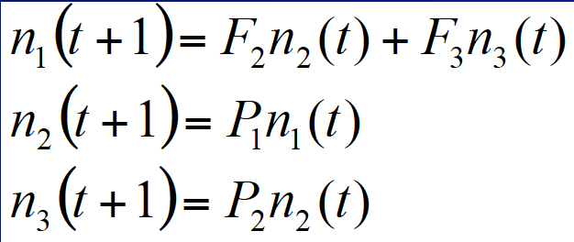
Mathematical representation

Slide 37
Mathematical representation

Slide 38
Mathematical representation

Slide 39
Mathematical representation
Notes:
All good with those three equations?

Slide 40
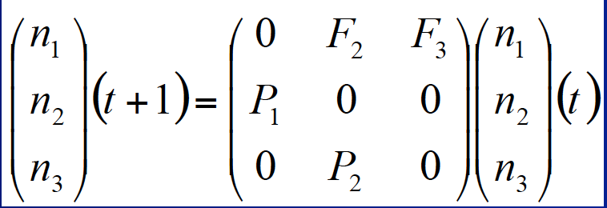
Leslie Matrix (Leslie, 1945)
Square matrix with one row and column per age/stage class
Population size vector n(t) which has one row per age/stage class
t+1
t
Notes:
Leslie (1945) realized that the system of equations representing the transitions amongst stages can be represented as a matrix
Used broadly in ecology to represent ecological structure. Extensions can represent predator prey dynamics and/or competition, can even be used to represent forest succession dynamics
The population is described by a vector n(t) which has one row per age/stage class
Explain t and t+1
First row = fecundity
Off-diagonal = persistence
Writing it in matrix format allows for the use of linear algebra to uncover properties of the population

Slide 41
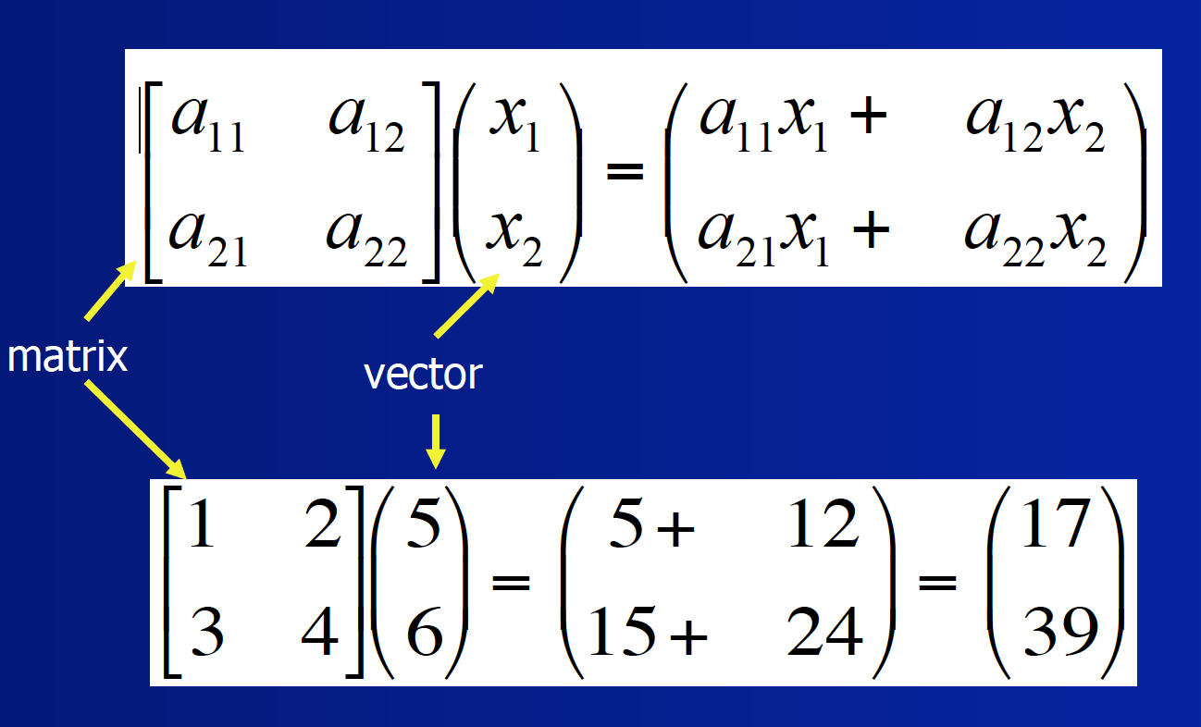
Matrix syntax refresher
A rectangular array of elements
Format rows x columns
A vector is a one-column matrix
Elements are identified by subscripts,
e.g. a₂₁ is the element in row 2 and column 1.
Notes:
A rectangular array of elements (numbers, variables, functions etc.)

Slide 42
Matrix multiplication refresher
Notes:
Square matrix multiplied by a vector gives back a vector

Slide 43
Matrix multiplication refresher

Slide 44
Matrix multiplication refresher

Slide 45
Matrix multiplication refresher

Slide 46
Matrix multiplication refresher

Slide 47
Leslie Matrix
t
Notes:
All the ways to get new n1

Slide 48
Leslie Matrix
t
Notes:
Which equations depend on one another?

Slide 49
Leslie Matrix
t
Notes:
Which equations depend on one another?

Slide 50
Leslie Matrix
t
Notes:
Which equations depend on one another?

Slide 51
Leslie Matrix
t
Notes:
Which equations depend on one another?

Slide 52
Leslie Matrix
t
Notes:
Which equations depend on one another?

Slide 53
Leslie Matrix
t
Notes:
Which equations depend on one another?

Slide 54
Leslie Matrix
t
Notes:
Which equations depend on one another?

Slide 55
Leslie Matrix
t

Slide 56
t+1
t
56
Notes:
TA will cover in this week’s tutorial on your assignment, and many online resources exist
https://www.mathsisfun.com/algebra/matrix-multiplying.html

Slide 57
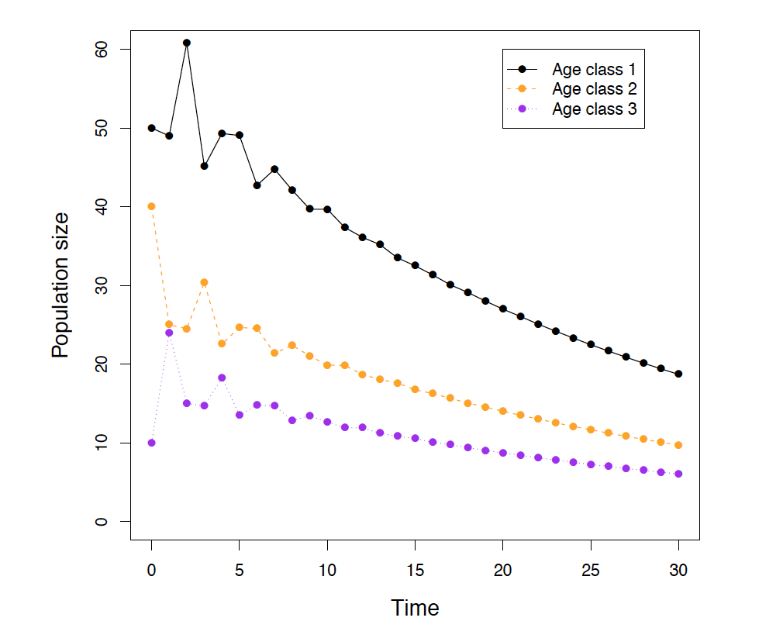
Properties of Leslie Matrices
Age distribution stabilizes → Stable Age Structure
Growth rate for all age classes becomes the global 𝞴 → Finite rate of increase
Notes:
Linear algebra allows for the calculation of this stable age structure, and lambda, from the Leslie matrix.
Don’t need to do the simulations in excel, can actually figure out directly from the equations.

Slide 58
Interactive Leslie Matrix
https://www.montana.edu/screel/teaching/bioe-440r-521/leslie.html

Slide 59
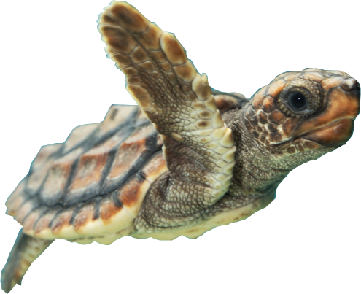
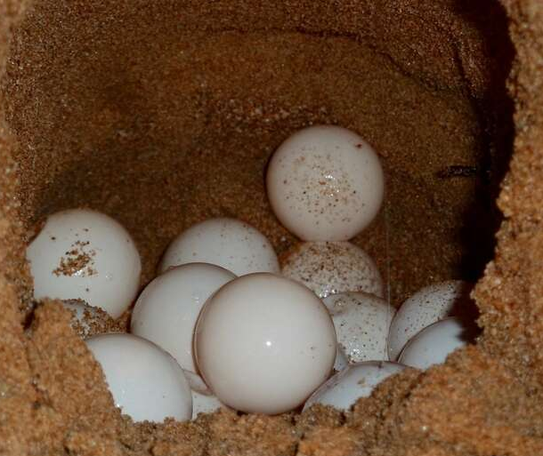
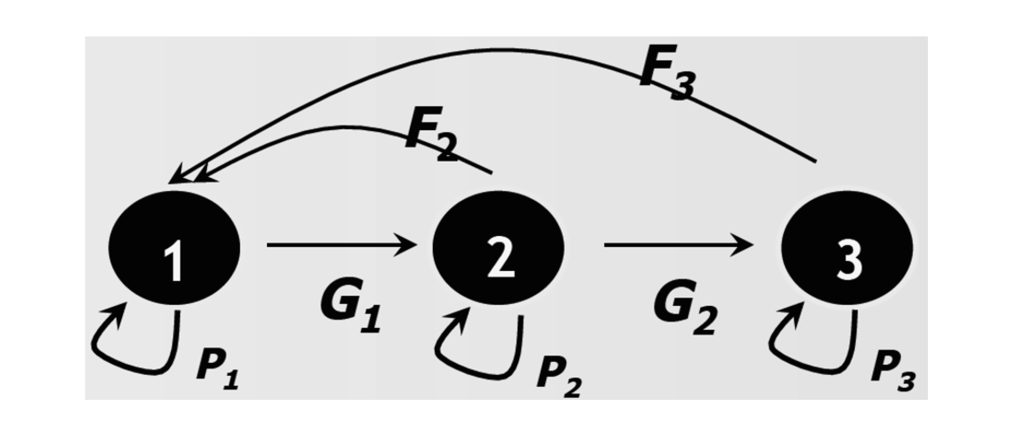
Stage structure
Crouse et al. 1987. Ecology
Notes:
Stage-structured models are often more useful for several
reasons:
• It's often difficult or impossible to age animals and
plants accurately.
• In some organisms, survivorship and fecundity are more related to size than
to age.
• Focusing on life-cycle stages helps to focus attention on
the critical transitions that may provide opportunities for management.

Slide 60
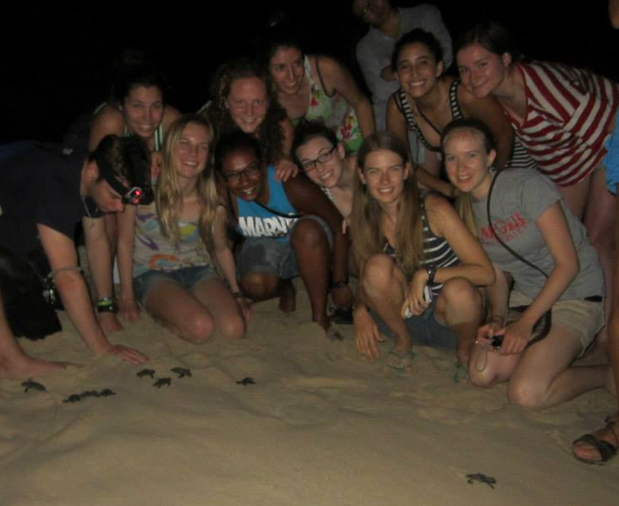
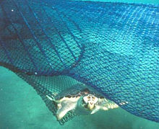
Sensitivity analysis
Sensitivity: change in outcome caused by a given change in parameter
Simulate changes to population that impact different parameters
The impact varies depending on the age/stage class altered
Notes:
Sensitivity: change in outcome caused by a given change in parameter
You can also use sensitivity analysis to understand what purposeful changes to a parameter through things like management interventions will have on the outcomes. In PVA, the main outcome of interest is the value of lambda, since it determines whether populations grow or shrink over time
where in the life cycle you make the change happens makes a big difference:

Slide 61
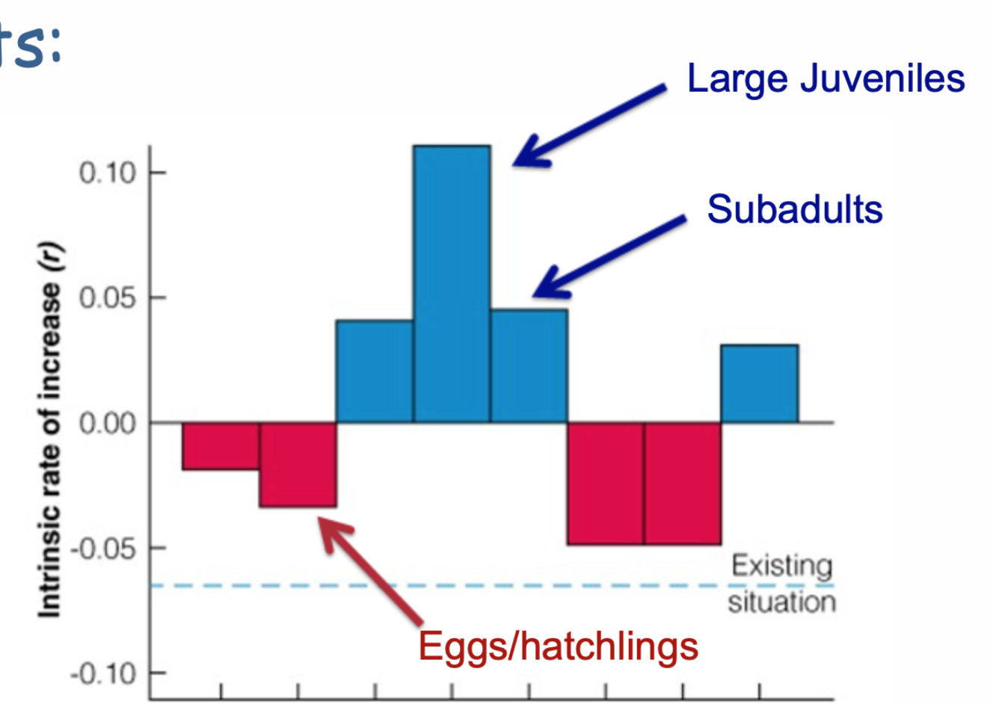
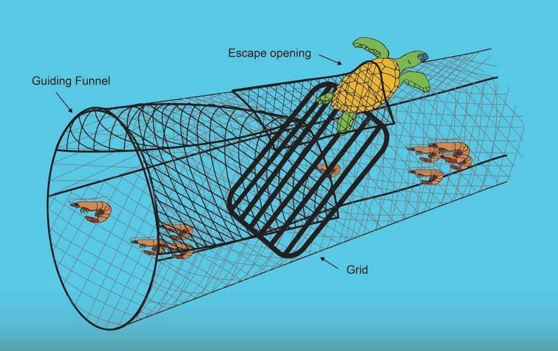
Sensitivity analysis
Crowder et al. 1994 Ecological Applications
Notes:
double fecundity or increasing survival to 1

Slide 62
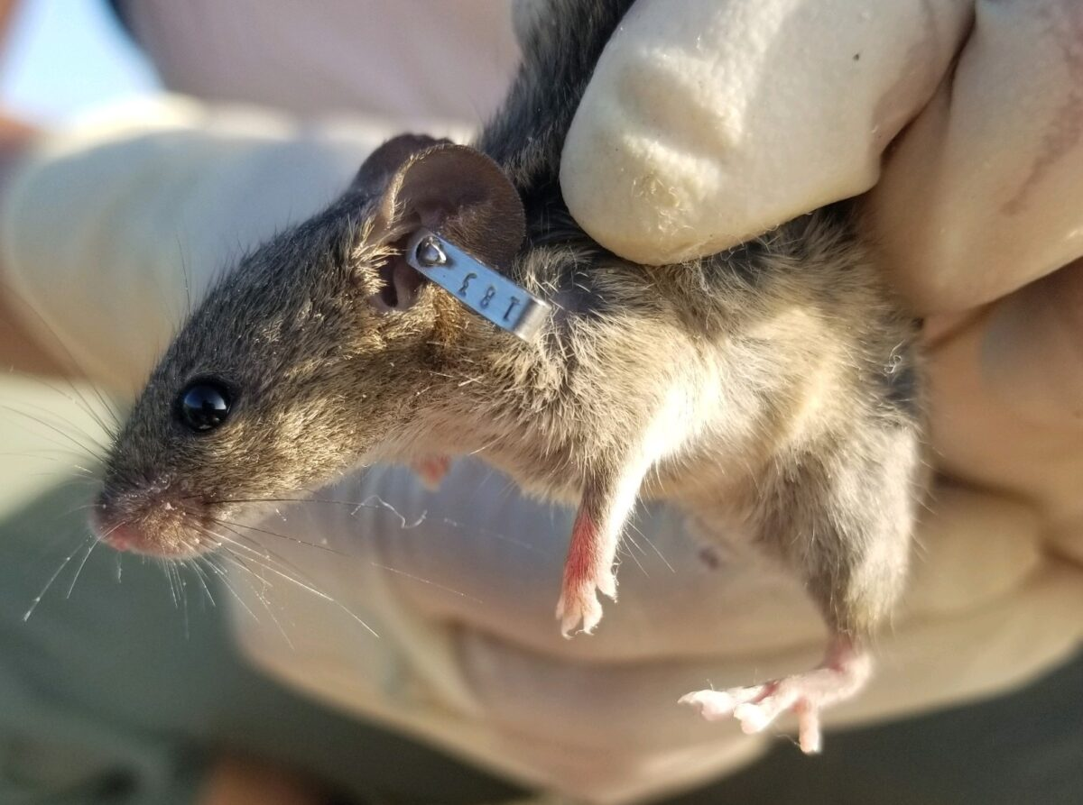
Data needed for demographic PVA
Estimating age/stage specific rates:
Mark-recapture studies with tags
Photo-ID data with individual identifiers
Roadkill surveys
Clutch size
OR
Modelled relationships with proxies
Notes:
Usually a much more expensive study system
Much smaller sample size or need to use a lot of other estimates
Others?

Slide 63
4. PVA Extensions and limitations

Slide 64
PVA limitations
Oversimplification of the population dynamics
Important parameters are hard to measure - often require proxies or lab studies
Considerable uncertainty of predictions
Notes:
Think about how weather forecasts get less and less accurate the further you go in the future. It’s important to make continuous updates to models. When data are limited (and they always are), you must decrease the time horizon and acknowledge uncertainty in decision process.
species interactions another dimension not captured
Can be very helpful at evaluating the relative usefulness of policies

Slide 65
PVA Extensions
Individual-based PVA (VORTEX package)
Metapopulation PVA (META-X package)
Integral projection models (Coulson 2012 Oikos)
Integrated population models (Schaub et al. 2007 Conservation Biology)
Notes:
Importance of finding new terminology when researching a topic!
links to genetics - but caveats
Continuous traits, density-dependent, stochastic models
Incorporating measurement error and the detection process

Slide 66
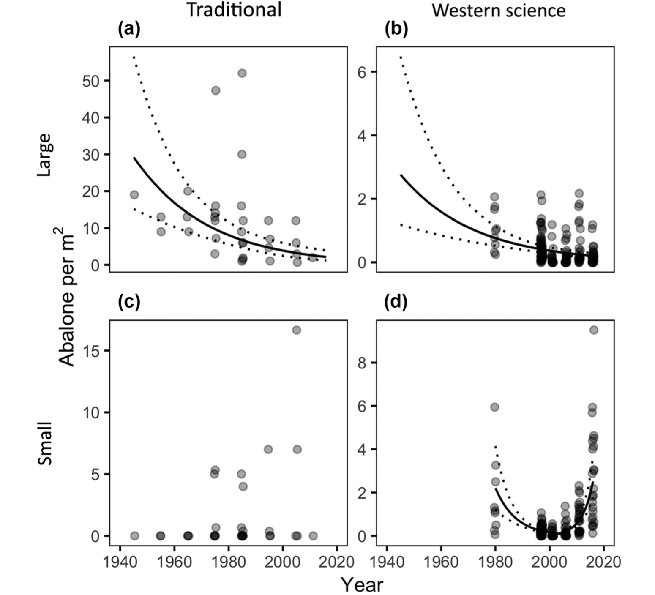
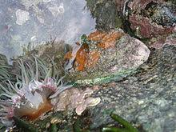
Beyond PVA
Heiltsuk Knowledge Western Science
Monitoring information is not limited to Western sources
PVAs can be incorporated in a Structured Decision-making process (See ENSC 4002)
Lee et al. 2018. Conservation Letters
Notes:
Heiltsuk central coast of BC
Quantitative data can be given more credibility even if gathered improperly
Sometimes the effort needed to collect better PVA data could be used much more effectively for management, even given uncertainty!
ENSC course is open to bio students

Slide 67
Take Home Messages
PVA is a key tool for understanding conservation needs and outcomes
More realism = More data needed
Life stage(s) at which interventions are directed can make a big difference
E.g., prevent more serious sea turtle declines by targeting adults with Turtle Excluder Devices
PVA is not the only factor that should be considered in conservation decisions
Notes:
Any questions on anything I’ve covered so far?

Slide 68
5. Assignment #1

Slide 69
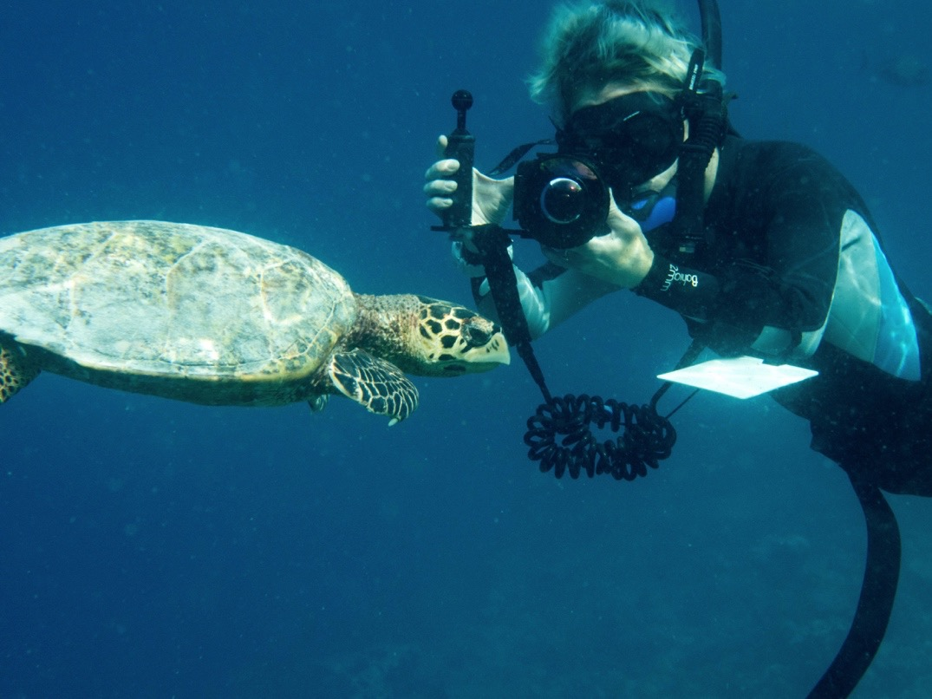
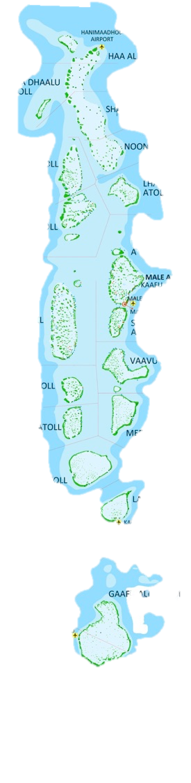




Assignment #1 - Reserve Design
Atoll 1:
Population = 200
𝞴= -0.025
SD=0.0005
You are tasked with the placement of a new marine protected area in the Maldives
You have the choice of 3 atolls
Atoll 2:
Population = 50
𝞴= 1.5
SD=2.5
Atoll 3:
Population: 300
𝞴=0.2
SD=0.05
Notes:
Post-assessment
How will I ensure that my learners walk away with the key points?
For simplicity, assume the size of the sites is all identical
Add graph of estimated trajectories with marine reserve
Major fishing village
Site of intense coral bleaching
Largest concentration of resorts

Slide 70
Assignment #1 - Reserve Design
Simulate population trajectories with stochasticity in Excel
Which atoll would you choose and why?
What biases might be present in the tourist-collected data?
Which other factors are important to consider?

Slide 71
Assignment #1 - Reserve Design
TA-led tutorial this Thursday on PVA in Excel (6pm EST on Zoom)
Assignment materials on Brightspace
Soft Deadline June 15th (firm deadline for all 3 assignments August 15th)
Notes:
TA workshop next week on PVA in Excel
Assignment materials on brightspace
Soft Deadline June 15th

Slide 72
Next Week:
Digging deeper into Stage Structured Models, Sensitivity, and Elasticity

Slide 73
Questions?
Emma.Hudgins@Carleton.ca
Office hours by appointment (Zoom or live in Nesbit 338)

Slide 74
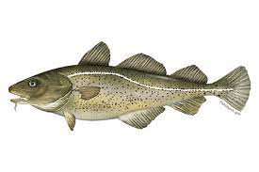
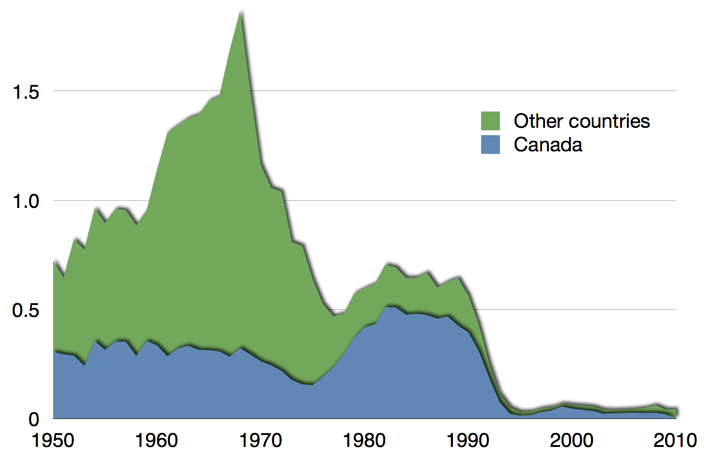
PVA gone wrong - Atlantic Cod
“VPA-based abundances consistently depict lower recruitment levels than do survey-based estimates in recent years. More important is the observation that from the early 1980s the VPA-based trend shows a decline where none is apparent in the survey-based trend. ”
Catch (Millions of Tonnes)
Myers et al. Ecological Applications
Notes:
Age structured ‘virtual population model’ – a type of early PVA, helped show that the preferential harvest of older fish was going to lead to declines not visible from the catch data

